Slide 1
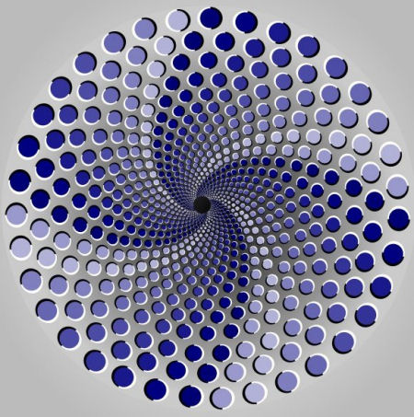
Optical Illusions

Slide 2
Ambiguities
The following pictures are ambiguities because they can be perceived in more than one way.

Slide 3
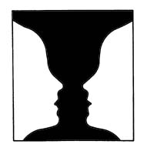
What do you see in this picture?

Slide 4
Do you see a vase or two people face to face?

Slide 5
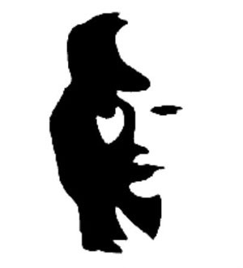
What do you see in this picture?

Slide 6
Do you see a woman’s face or a musician?

Slide 7
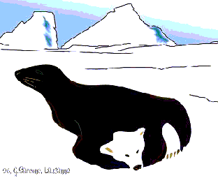
What do you see in this picture?
http://www.snipitron.com/items/cache/79/16/hlavolamy.szm.sk/images/optical-illusions-seal-bear.gif

Slide 8
Did you see a seal or a bear?

Slide 9
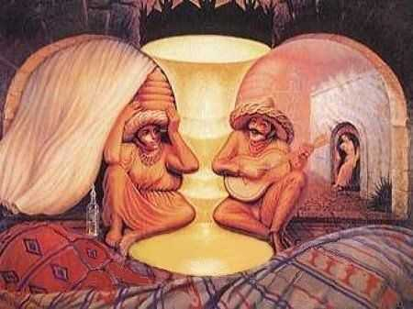
What do you see?
puzzles.about.com/.../FocusPlease.htm

Slide 10
This is a more elaborate version of the vase / two faces picture.

Slide 11
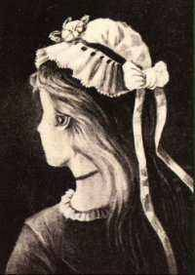
What do you see in this picture?
puzzles.about.com/.../FocusPlease.htm

Slide 12
Do you see a pretty young woman or an old woman?

Slide 13
Size and Depth Perception Visual Illusions
How we perceive something is affected by its relationship to the other objects around it.

Slide 14
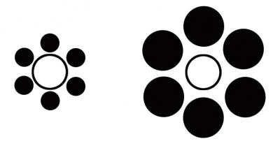
Which white circle is larger?
www.wisebread.com/optical-illusions-that-make-you-fatter-and-your-wallet-lighter

Slide 15
The circles are in fact identical in size. BUT, they look different due to their surroundings. The circle on the right is dwarfed by the large black circles, the one on the left overpowers them.

Slide 16
Is this hat taller than it is wide?
www.wisebread.com/optical-illusions-that-make-you-fatter-and-your-wallet-lighter

Slide 17
The height and width are identical.

